Slide 1
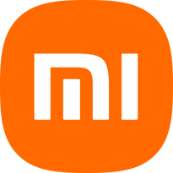


Xiaomi
XIAOMI
MARKETING MIX
By - Group 4

Slide 2
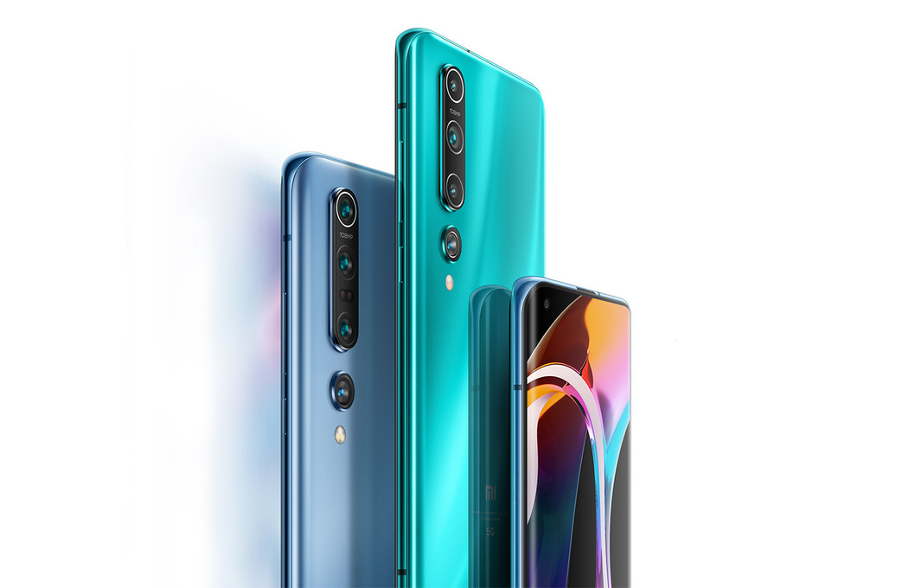
Xiaomi
CONTENTS
Background
Product
Segmentation
Promotion
Alternate Positioning

Slide 3
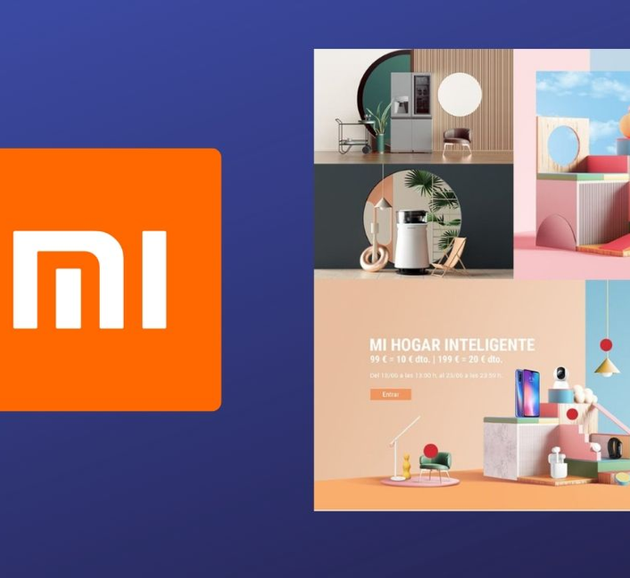
Xiaomi
BACKGROUND
Xiaomi is electronics company based out of Beijing, China
It was found by Lei Jun and six others in 2010, Later that year company raised US$ 41 million in Series A round
Xiaomi entered Indian market in 2015.
Opened first Mi store in India in 2017.

Slide 4

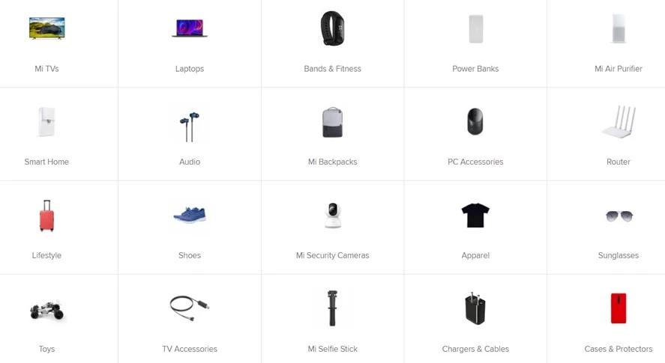
Xiaomi
PRODUCT
It markets its smartphones under three brands: Mi, Redmi, and POCO.
Initially focused on smartphones company expanded to Smart TV, Power Banks, speakers, laptops, smart bulbs etc.
More focused on design aesthetics than competitors.
It has dedicated gaming smartphone range named Black Shark
It has its own Android firmware MIUI.

Slide 5

Xiaomi
SEGMENTATION

Slide 6
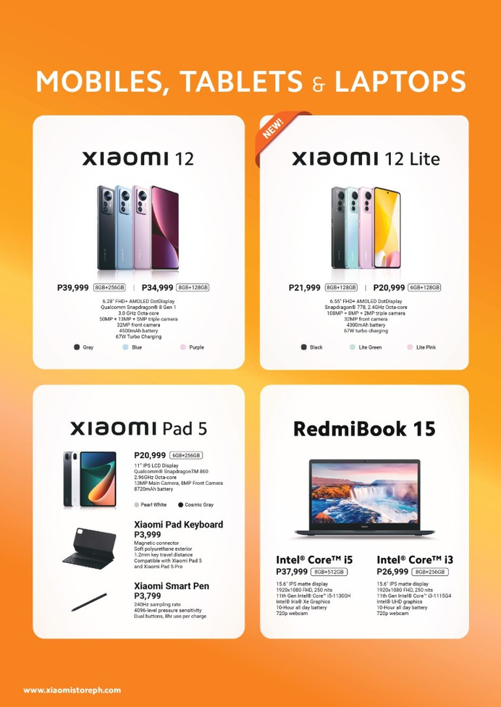
Xiaomi
PRICE
Xiaomi follows a competitive pricing strategy.
Xiaomi has smartphones in all ranges from budget friendly Redmi A1 to flagships like Xiaomi Mi13.
Redmi products are budget-friendly, it often ranges from Rs. 5,000 to Rs. 20,000.
POCO products are targeted to mid range segment, often ranges from Rs. 15,000 to Rs. 25,000.
MI's products are targeted to flagship series, often ranges from Rs. 30,000 to Rs. 1,00,000.

Slide 7
Xiaomi
Smartphone Category | Xiaomi | Realme | Samsung
Budget Phone (64GB Storage) | Redmi A2 (₹10,999) | realme Narzo N55 (₹12,999) | Galaxy M04 (₹11,999)
Mid-Range Smartphone ( 64GB Storage) | POCO X5 Pro (₹22,999) | realme Narzo 50 Pro (₹25,999) | Galaxy A23 (₹28,990)
Flagship Smartphone ( 256 GB Storage) | Xiaomi 13 Pro (₹89,999) | Apple iPhone 14 Pro (₹1,39,900) | Galaxy S23 Ultra (₹1,24,999)
PRICE
Examples
Realme does not have any smart phone in flagship range
50 inch | 4K | UHD Smart TV | 50 inch | 4K | UHD Smart TV | 50 inch | 4K | UHD Smart TV | 50 inch | 4K | UHD Smart TV
Mi X Series (₹44,999) | Sony Bravia (₹74,900) | Oneplus U Series (₹49,999) | Samsung Crystal (₹61,900)
11 inch Tablet | 11 inch Tablet | 11 inch Tablet
Xiaomi Pad 6 (₹41,999) | Samsung GalaxyTab S7 (₹49,999) | Apple iPad Pro (₹81,900)

Slide 8
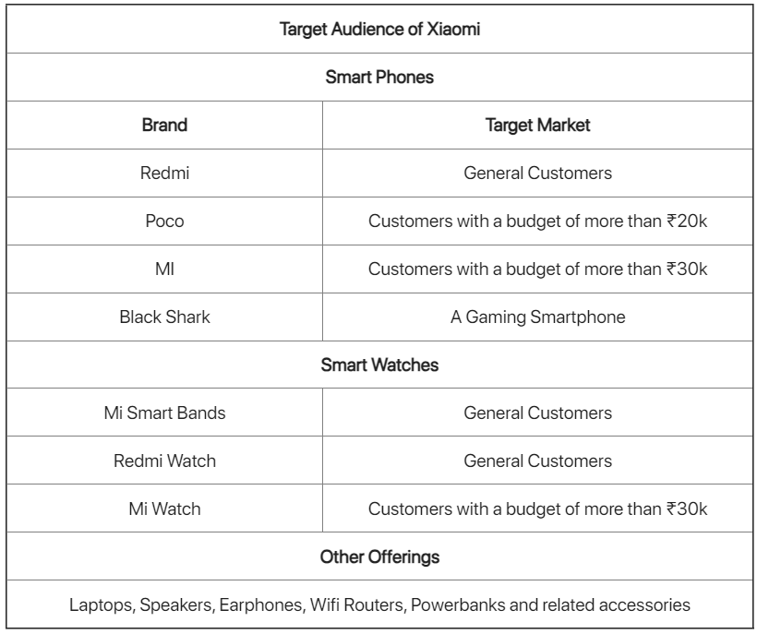
Xiaomi
CUSTOMER SEGMENTATION
Xiaomi's market positioning aims to bridge the gap between the mass market and the high-end market.
Xiaomi clearly plans to rapidly extend its product line in order to obtain a competitive advantage in the highly competitive global market.
Over the years, it has enhanced its product
portfolio and now offers a wide range in not just the
smartphone category but also in various other
categories.

Slide 9
PROMOTION

Slide 10
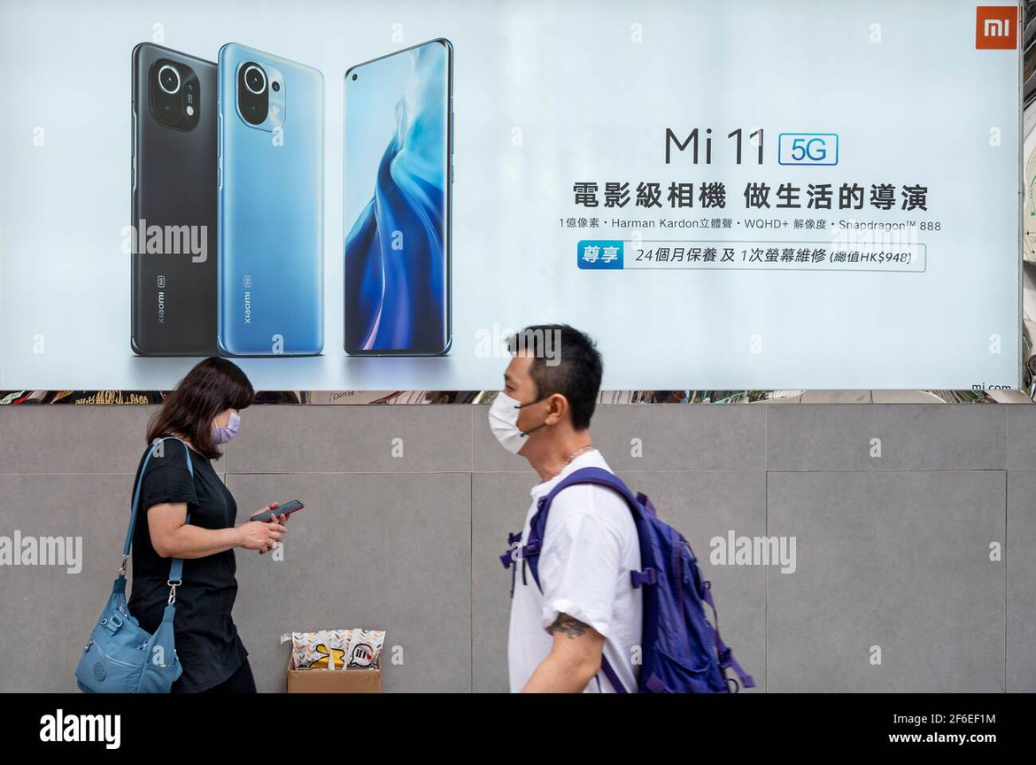
Xiaomi
Advertising
Pull strategy rather than push strategy.
Taglines for specific products such as :
1. Accelerate Your Life - Xiaomi Mi3.
2. Rise To Power - Redmi Note 3
3. Power has A New Look - Redmi 10 Power
social media and microblogging platforms like Facebook, Twitter, Instagram, and Weibo for interacting with customers, advertise items, and offer customer service.

Slide 11
Xiaomi
Public Relations
Participates in industry events, support sports teams, and establish alliances to expand reach and awareness.
In an effort to develop a cult following for its goods, Xiaomi often hosts local gatherings and fan festivals.
Under the VIP Users Center, Xiaomi offers a well-established program.
.

Slide 12
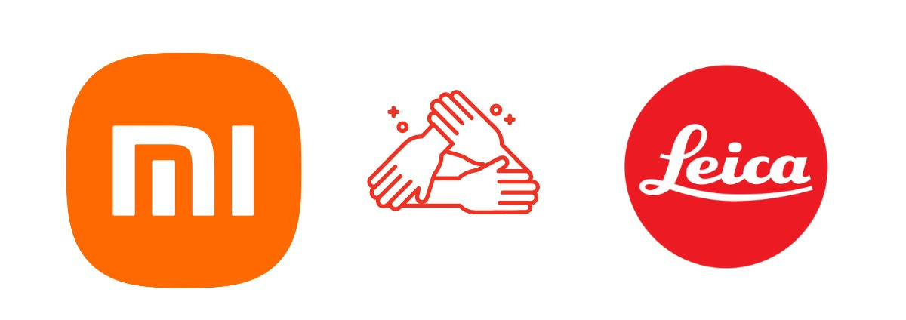
Xiaomi
Strategic Partnerships and Endorsements
As it did with Uber to promote its brand, they also work together with businesses that share similar goals to promote their goods.
Xiaomi has associated with Music, Cultural fests to appeal to younger demographics
One of the top online marketplaces, Flipkart, assisted in promoting Xiaomi.
Xiaomi's reputation for providing cutting-edge technology is strengthened through partnerships with organizations like Google and Qualcomm.

Slide 13

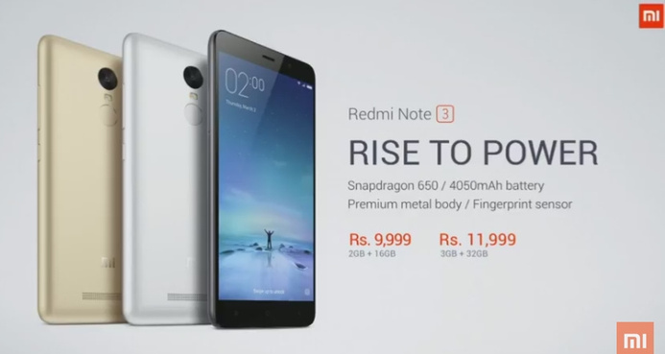
Xiaomi
Product Launches
Flash sales for creating urgent desire of the product.
Advertised its products by offering high-end goods at reduced prices.
As part of Xiaomi's innovative "Just For Fans" concept, devoted customers guide the creation of the device at every stage.

Slide 14
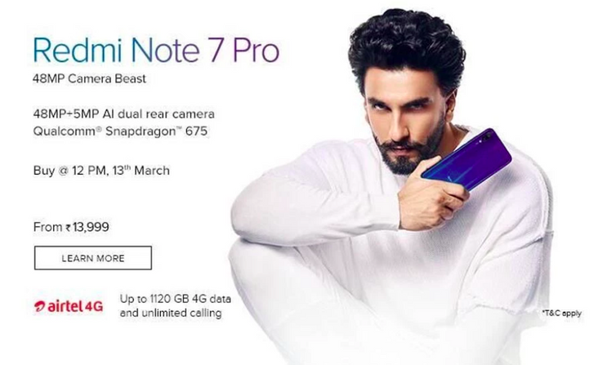
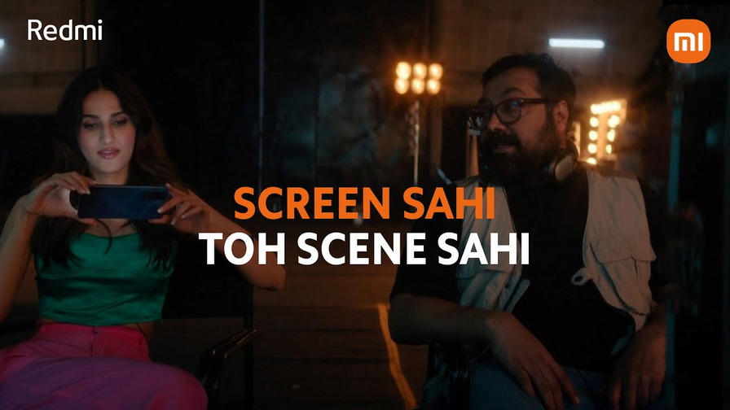
Xiaomi
BRAND AMBASSADORS OF XIAOMI
https://www.youtube.com/watch?v=1jMA-jftg_0&t=27s&ab_channel=XiaomiIndia
https://www.youtube.com/watch?v=2G6QSTSMB6U&ab_channel=RedmiIndia

Slide 15
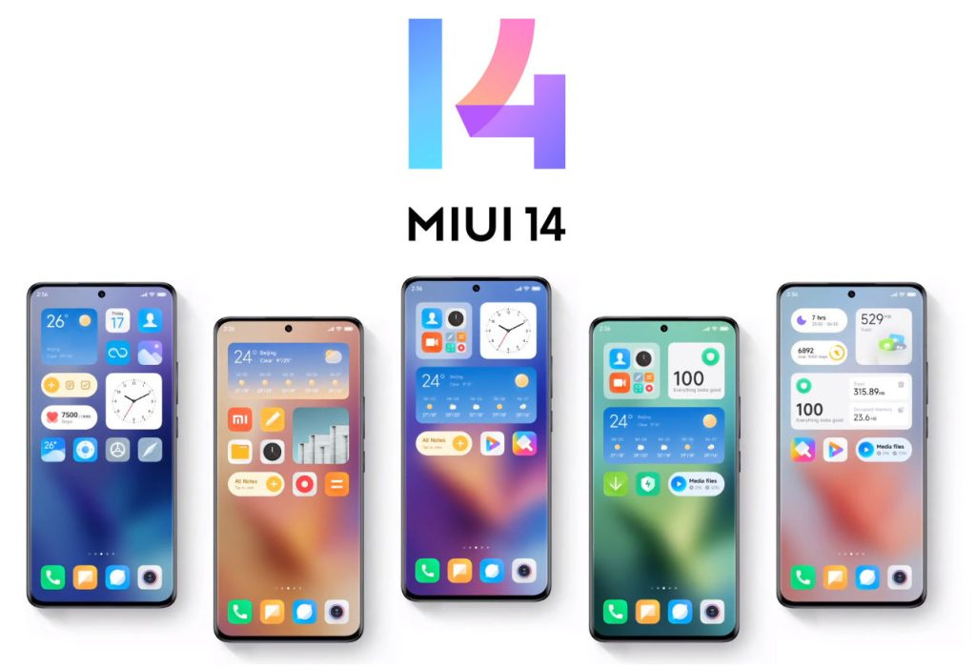
Xiaomi
PROMOTION
Xiaomi positions itself as Software company rather than an electronics manufacturing company.
To support this they have mostly used their home-built Android skin MIUI rather than using Android One which would result in lower prices.
Through its MIUI Xiaomi promotes its many value added services like Mi Credit, Mi Music etc.
Xiaomi pre-installs its many services apps in MIUI to promote these to its smartphone users through continuous adverts and notifications which is very irritant to many users.

Slide 16
Xiaomi
POSITIONING
Current Positioning
Alternate positioning
Xiaomi has positioned itself as 'value for money' and for the 'middle-class' segment.
Xiaomi can shift its focus towards premium phones and innovate its flagship specifications.
Xiaomi emphasises being a software company and hence advertises its apps and services through their MIUI
Xiaomi can develop more as a hardware company which maximises profits by selling smartphones and not advertisements.
Xiaomi produces a lot of smartphones with clustered dates, which overwhelms the customers
Xiaomi should adopt the Less is More strategy with 2 smartphones a year, building a sense of quality

Slide 17
Xiaomi
POSITIONING
Current Positioning
Alternate positioning
Xiaomi has often tried to imitate Apple's iOS on its MIUI and received flak for its imitative positioning
Xiaomi can develop its MIUI uniquely and rather try to gain the image of an innovative company
Xiaomi, a Chinese company which produced many phones at a time, developed a sense of cheap products in the Indian market
Xiaomi can promote Xiaomi India by more extensive integration of its manufacturing inside India, which can create a positive appeal to Indian customers

Slide 18
Xiaomi
THANK YOU

